Slide 1
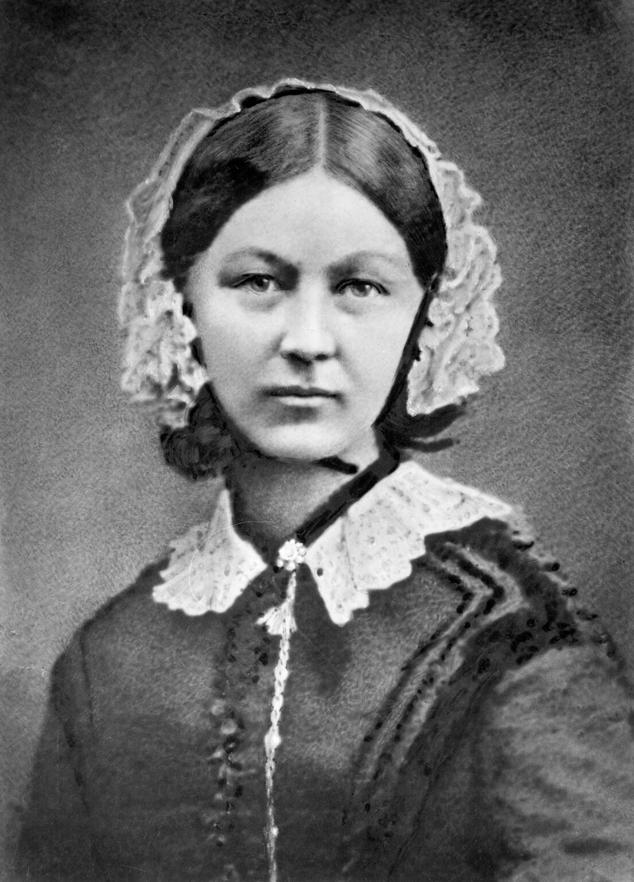
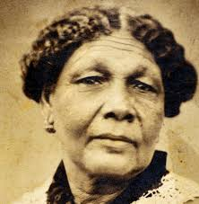
WALT: find out about important people from the past
History Curriculum: find out about the lives of significant individuals in the past who have contributed to national and international achievements.

Slide 2
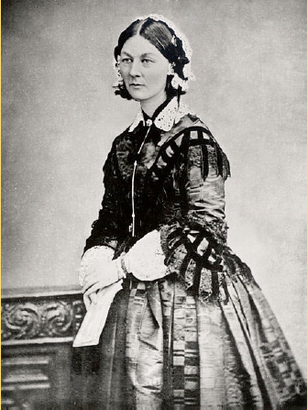
Is this person rich or poor?
Was this person born before or after the Great Fire of London?
What job do you think this person has?
What can we tell about this person from this picture?

Slide 3
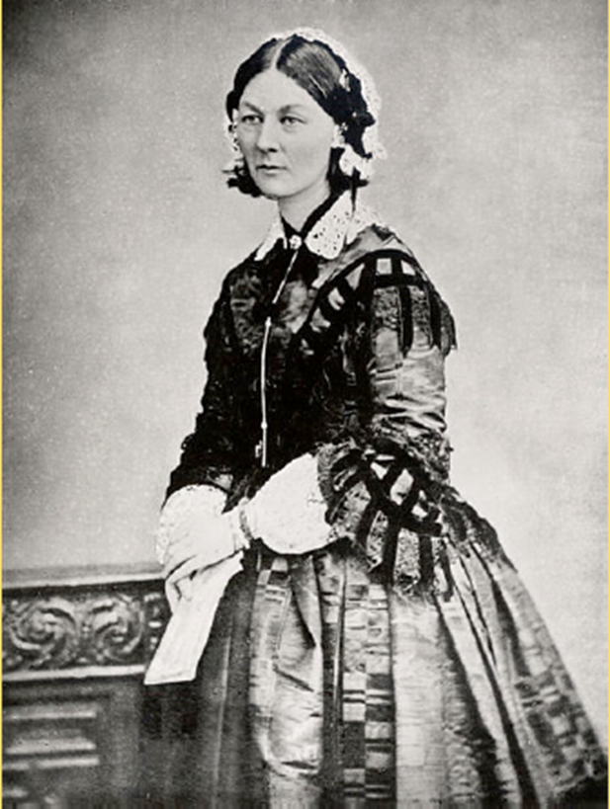
This picture shows a woman called Florence Nightingale. She was born in 1820 in Florence in Italy. She was named after the city she was born in. Her family was British and they moved back to England when Florence was still a baby. She had an older sister called Parthenope.

Slide 4
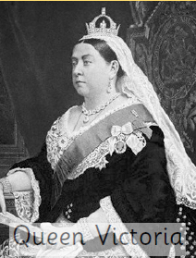
Florence was alive when Queen Victoria was queen of England. Britain was a very different place at this time. Men and women were not equal and there was a big divide between rich and poor people.

Slide 5
1666
Great Fire of London
1606
Gunpowder Plot

Slide 7
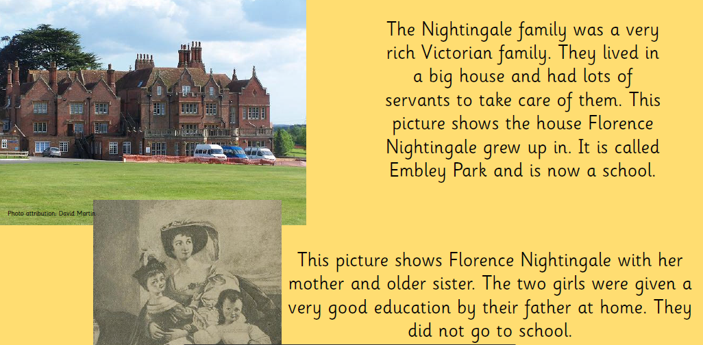

Slide 8
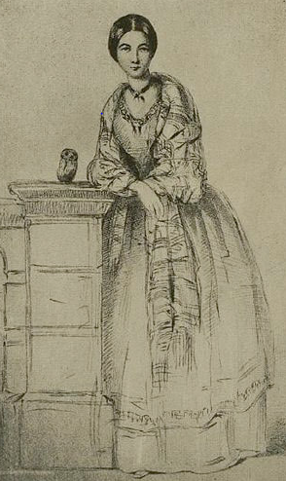
At this time, daughters from wealthy families
were expected to make a good marriage and run
a household. Florence didn’t want to do this.
From a young age, she was interested in nursing
and taking care of people so she decided to
become a nurse. Her parents didn’t want her to
do this. At this time, wealthy women did not
work, let alone work as a nurse. Nurses were
usually poorer women and her parents thought
this would be very unsuitable for her.

Slide 9
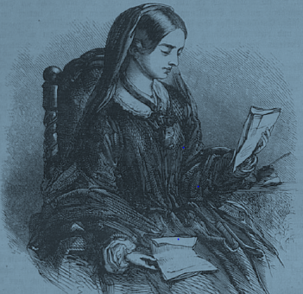
However, Florence was determined to become a nurse. She was a Christian and believed that God was calling her to be a nurse and help people. Eventually, her parents realised she wasn’t going to marry (even though she had lots of offers from lots of rich men) and gave in.
In 1851, when Florence was 31 years
old, she went to train as a nurse in
Germany. She then returned to England
and became the supervising nurse for a
hospital for rich women in London.
It took her a long time but she showed determination and perseverance in order to achieve her dreams.

